Slide 1
Predicting DIABETES
By: Lorena Arias and Karen Serrano

Slide 2
TABLE OF CONTENTS
01
02
03
04
Dataset Description
Classification Target
KNN Algorithm
Decision Tree

Slide 3
Dataset dESCRIPTION
Source of the DataSet : Kaggle
This dataset predicts whether the patient has diabetes. The dataset has 768 instances and 8 features + 1 Target Variable.
Pregnancies
Glucose
Blood Pressure
Skin Thickness
Insulin
BMI ( Body Max Index )
Diabetes History
Age
Outcome

Slide 4
cLASSIFICATION tARGET
The classification target of this dataset is to predict whether a person has diabetes or not, based on the given input features. The output variable is binary, where '1' indicates the presence of diabetes and '0' indicates the absence of diabetes.

Slide 5
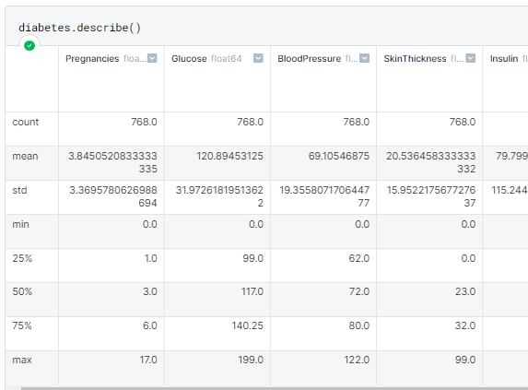
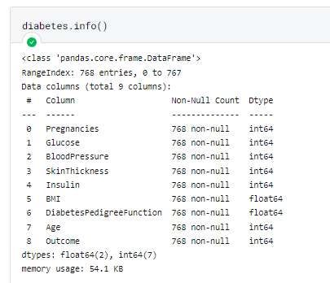
Descriptive Statistics

Slide 6
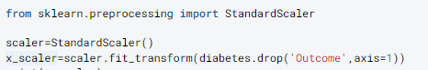
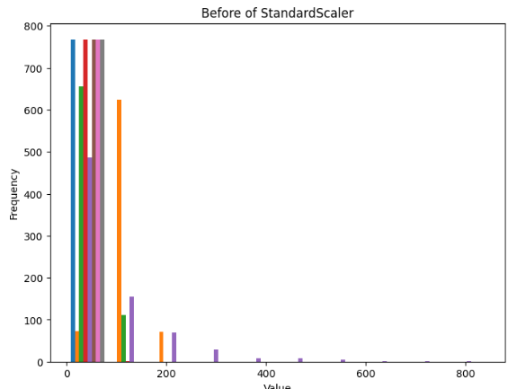
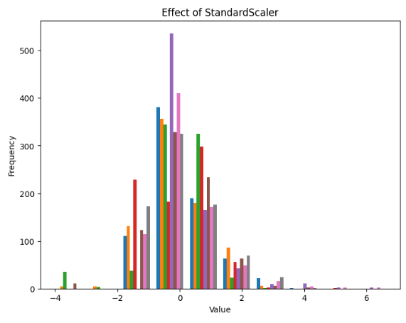
Data Preprocessing

Slide 7
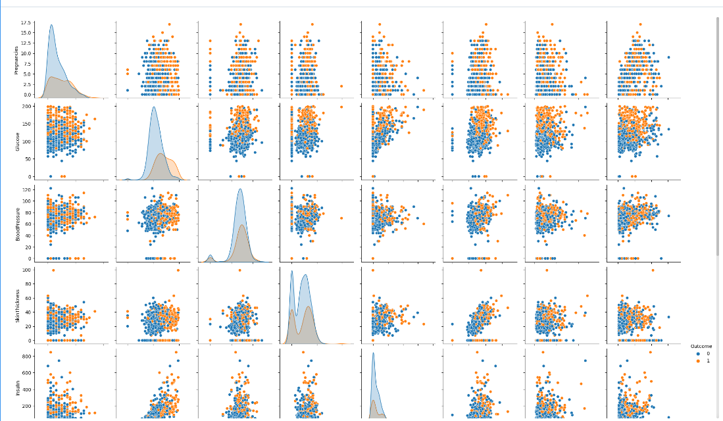

Slide 8
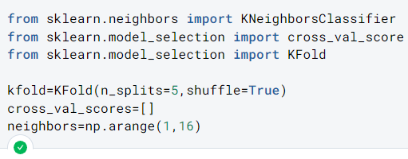

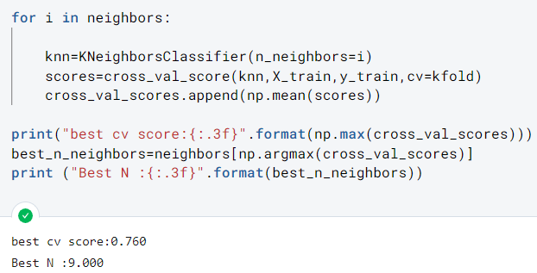

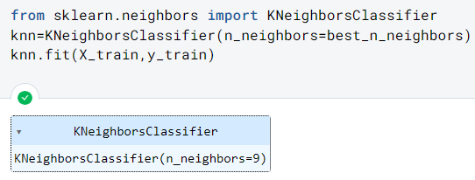


K-Nearest Neighbors
K-Fold Cross Validation estimates the performance of the model.
The best K value, which gives the highest accuracy. This is obtained by indexing the neighbors array with the index of maximum value.
Notes:
The dataset was split into the target data and test data, then split into train and test (X, y).

Slide 9
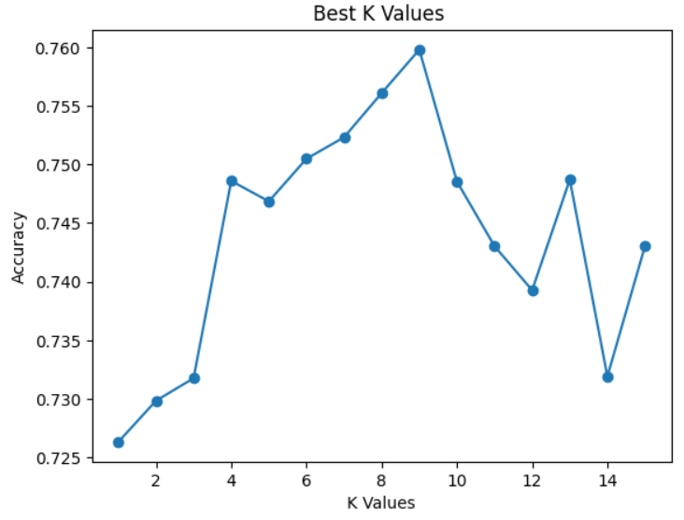
bEST k vALUES

Slide 10

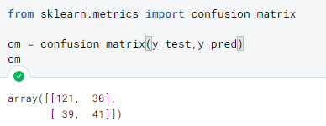
Calculation of Accuracy

Slide 11
Performance
Accuracy = (TP + TN) / (TP + FP + FN + TN) =
(121 + 41) / (121 + 30 + 39 + 41) = 0.71 or 71%
Precision = TP / (TP + FP) =
121 / (121 + 30) = 0.80 or 80%
Recall = TP / (TP + FN) =
121 / (121 + 39) = 0.76 or 76%
F1 Score = 2 * (Precision * Recall) / (Precision + Recall)
= 2 * (0.80 * 0.76) / (0.80 + 0.76) = 0.78 or 78%

Slide 12
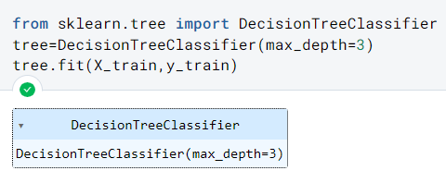
Decision Tree
Tuning Model Hyperparameters
The maximum depth of the tree is set to 3 to prevent overfitting.

Slide 13
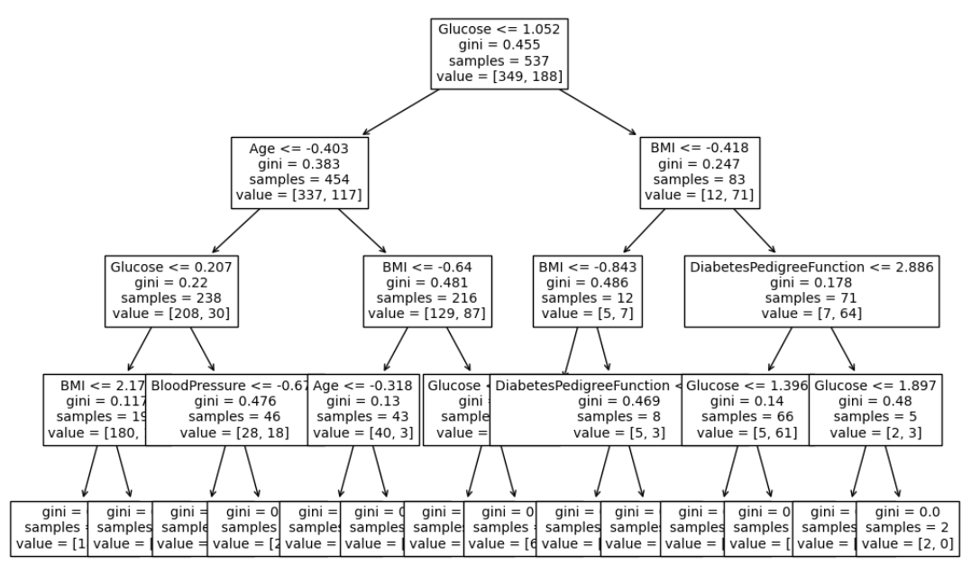
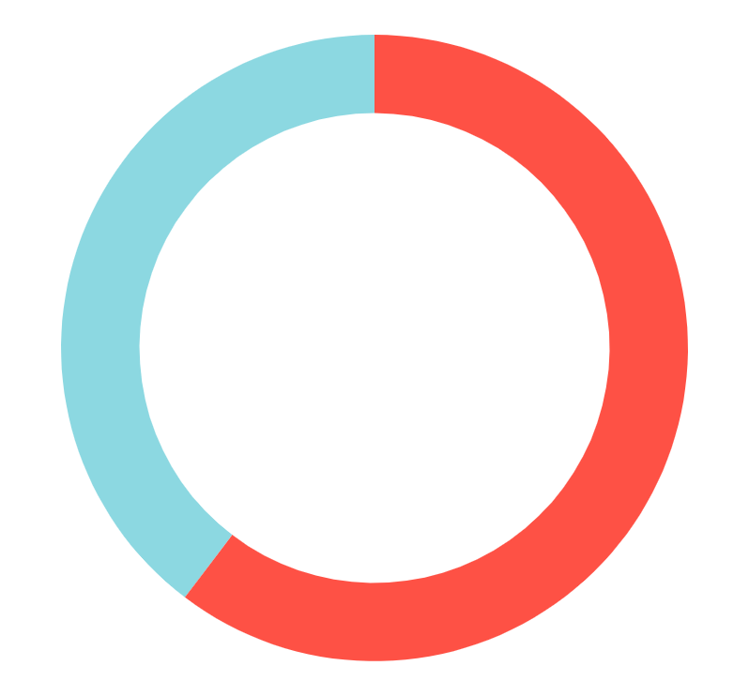
RISK AGE TyPE 1 DIABETES
4-7 years
60%
Despite being red, Mars is actually a cold place
10-14 years
40%
Mercury is the closest to the Sun of them all
Follow the link in the graph to modify its data and then paste the new one here. For more info, click here
T
1

Slide 14
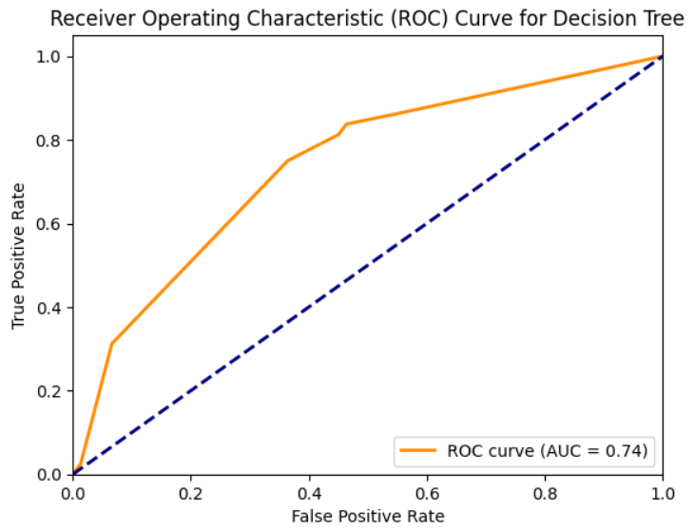
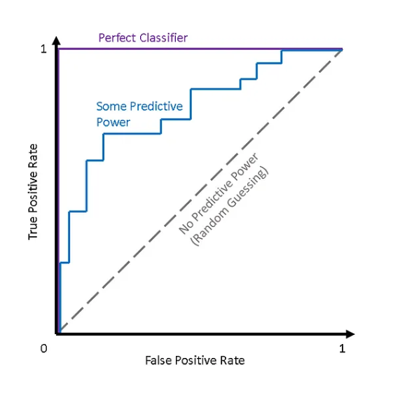
ROc Curve for Decision Tree

Slide 15
CONCLUSIONS

Slide 16
CONCLUSIONS
Based on the results obtained, we can conclude that the accuracy levels of the KNN and Decision Tree models are not exactly the same, but they are relatively close. The KNN model has a slightly higher accuracy score of 0.71, while the Decision Tree model has an accuracy score of 0.67. Based on the Decision Tree, 3 features are crucial for predicting diabetes: Glucose levels, Age, and BMI (Body Max Index).
Therefore, we can say that both models have comparable accuracy levels in predicting the target variable.

